Slide 1

ESE Revision Package

Slide 2
General Information
Problems to be assessed: Problem 2 – 11
(Problem 1, 12 and 13 will not be tested)
Date and time of ESE: 25th August 2017, 3.00pm
Duration of ESE: 90 minutes
Format of ESE: Multiple choice, fill-in-the-blank and essay
Total Mark: 40 marks
Mode of ESE: Online eQuest

Slide 3
General Information
How will you be tested in G101 ESE?
During the G101 ESE, you can refer to any resource that is stored in your laptop (e.g. 6th P, worksheets, etc.).
You are NOT allowed to refer to any text books but you are allowed to refer to paper notes. If there are more than one sheet of paper that you intend to refer to, they must be bounded together (i.e. not in loose pieces).

Slide 4
General Information
How will you be tested in G101 ESE?
The ESE will test your ability to apply what you have learnt in class (e.g. identifying verifiable claims, evaluate quality of information sources, etc.) through the scenarios given in the ESE paper. The scenarios given in the ESE will not be the same as the ones you have seen in the problem packages or quizzes.
You are required to demonstrate your ability to apply your thinking skills which you have learnt in your G101 lessons to the scenarios given in the ESE.

Slide 5
Learning Outcomes to be tested in G101 ESE
Critical Thinking Framework
Problem 1
Will not be tested
Problem 2
Distinguish verifiable claims from non-verifiable claims.
Evaluate quality of claims and arguments through:
Logical fallacies (i.e. bandwagon, appeal to improper authority and slippery slope).
Cognitive biases (i.e. anchoring bias, loss aversion).
Problem 3
Evaluate the quality of information sources based on key criteria and standards (S.U.R.E)_Source:
Sources: Make sure the source of information is credible.
Understand: Clarity in what you are reading.
Research: Investigate thoroughly before making a conclusion; check with multiple sources.
Evaluate: Look for different angles.

Slide 6
Learning Outcomes to be tested in G101 ESE
Scientific Thinking Framework
Problem 4
Demonstrate awareness of what thinking scientifically entails.
Explain the scientific method and the rationale underpinning each step.
Apply the scientific method and address issues.
Explain the benefits of scientific thinking in everyday life.
Problem 5
Substantiate claims by conducting an investigation using criteria for scientific evidence (i.e. objectivity, validity, reliability).
Conduct basic literature review to inform the investigation process.
Design and explain appropriate sampling strategies to ensure an unbiased sample.
Record data in table format using Microsoft Excel.
Present proposal.
Problem 6
Prepare raw data suitable for data analysis.
Analyse data using basic descriptive statistics.
Make correct interpretation from the results of data analysis.
Explain limitations of the investigation that undermine the conclusiveness of the claim.

Slide 7
Learning Outcomes to be tested in G101 ESE
Design Thinking Framework
Problem 7
Explain the 5 key modes (Empathy, Define, Ideate, Prototype and Test) of the design thinking model.
Apply project management skills in a design thinking project.
Apply design thinking mode “Empathy” in problem solving which include:
Identify relevant users.
Empathise with users via strategies such as (i) observing them, (ii) engaging them through effective interview techniques and (iii) immersing yourself in their experiences, so as to gain valid insights into their needs.
Problem 8
Apply design thinking mode ‘Ideate’ in problem-solving, which includes:
Explain reasons for exploring multiple & diverse solutions in response to APS.
Explain reasons for establishing different criteria of a suitable solution.
Prioritise solutions based on criteria and context of the problem.
Apply design thinking mode ‘Prototype’ in problem-solving which includes:
Identify various strategies of prototyping a process or product for the APS and explain their purpose.
Develop a suitable prototype for APS.

Slide 8
Learning Outcomes to be tested in G101 ESE
Design Thinking Framework
Problem 9
Apply design thinking mode ‘Test’ in problem-solving, which includes:
Identify different methods of evaluation to determine the suitability of proposed prototype.
Conduct suitable method of evaluation of the proposed prototype.
Systems Thinking Framework
Problem 10
Identify parts of a system.
Explain the relationship between parts and whole in systems.
Analyse patterns of relations that change over time in systems.
Apply systems thinking in problem solving.
Problem 11
Explain the benefits of using Systems Thinking in problem solving.
Apply Systems Thinking to identify root causes in complex problems:
Identify root cause(s) in the given context.
Apply Systems Thinking to respond to complex problems.

Slide 9
Learning Outcomes to be tested in G101 ESE
Problem 12
Will not be tested
Problem 13
Will not be tested

Slide 10
How should I revise for ESE?
You should be prepared for your ESE by doing the following:
Download and revise all the 6th P from Problem 2 – 11.
Download and revise all the Quiz Review Packages from Problem 2 – 11.
Attempt the Practice Questions in this Revision Package (Slides 19 - 25).
Attempt the ESE Practice Paper found in this Revision Package (Slide 28).
Seek clarification with your Lecturer before the ESE.

Slide 11
Tips on Answering ESE Questions
Read the contexts and questions carefully before you answer the questions.
Answer specifically to what the question is asking.
Do not simply copy directly from 6th P.
Apply what you have learnt to answer the question.
You are NOT required to draw in additional information from beyond the context to answer the question
Spend an appropriate amount of time for each question.

Slide 12
How should I revise for ESE?
Be clear and concise in the way you explain your answers. Do not assume that the markers will understand the hidden meaning of your phrases.
Example:
Question: ….. Is this claim credible? Explain.
Response 1: No. (comment: The answer is correct but there is no explanation given on why it is not a credible claim. Hence this response will not score full marks.)
Response 2: No. Because his analysis is flawed. (comment: The answer is correct but the explanation given is vague and does not explain where the analysis is flawed. Hence this response will not score full marks.)
Response 3: No. This is because his analysis is based on his own opinion and this is subjected to personal bias. (comment: This is a good response as the explanation is clear and correct. Hence this response will score full marks.)

Slide 13
Commonly used assessment verbs in G101 and how should I answer them?
Commonly used Assessment verbs | How should I answer the question?
Compare | Discuss the similarities and differences
Describe | Provide characteristics and features of how and why something happened
Evaluate | Make a judgement based on a set of criteria by stating whether the piece of research/information given is true OR to what extent do you agree with them
Explain | Relate the cause and effect OR Make relationships between the things evidently OR Provide the ‘why’ and ‘how’
Identify | Determine the key point in the context given OR Recognise and name it
Investigate | Come out with conclusions based on the context given
Suggest | Give a plan/idea/recommendation based on the context given

Slide 14
Here are some examples
of how you could approach your solutions.

Slide 15
Example 1
Problem 2
Learning outcome to be tested:
Evaluate quality of claims and arguments through:
Logical fallacies (i.e. bandwagon, appeal to improper authority and slippery slope)
Sample question:
John heard the following statement made by his peers: “Most people are voting Peter to be the president of student council.” John then made the following claim, ”Peter must be the best qualified person among all the candidates for this post.”.
Explain if John’s claim is credible?
[2 marks]
Example of good response:
This is not a credible conclusion because John is just following what the majority does (bandwagon effect) without knowing and examining all the candidates. [1 mark] His conclusion was made based on the opinion of majority without considering the quality of each candidate.[1 mark]
With the given response above, student will score a total 2 out of 2 marks for answering the above question.
Note:
No marks awarded for stating “John’s conclusion is credible”.
Student is expected to explain if John’s claim is credible or it is not credible.

Slide 16
Example 2
Problem 5
Learning outcome to be tested:
Design and explain appropriate sampling strategies to ensure an unbiased sample.
Sample question:
David likes to know if Singaporeans generally prefer to have drink A or B. So he asked three of his friends to try these two drinks and got their opinion before concluding which drink most Singaporeans prefer.
Evaluate David’s way of making such a conclusion.
[2 marks]
Example of good response:
David’s conclusion is incorrect and not credible. The conclusion he made was based on the opinions of just three persons [1 mark] and such sample size is not sufficient for him to extrapolate and conclude what the majority of Singaporeans prefer. [1 mark]
With the given response above, student will score a total 2 out of 2 marks for answering the above question.
Note:
No marks awarded for stating “David’s conclusion is incorrect and not credible”.

Slide 17
Example 3
Problem 11
Learning outcome to be tested:
Apply Systems Thinking to identify root causes in complex problems:
Identify root cause(s) in the given context.
Sample question:
With the given problem below,
“Customers are unhappy because the shipped products did not met the specifications stated during purchase.”
Using the “5 whys” questioning technique, identify the FIRST question you will ask in order to trigger the root cause analysis to the above problem.
[1mark]
Example of good response:
The first question to ask will be, “Why did the customers received products not according to the specifications stated during purchase?” [1 mark]
With the given response above, student will score a total 1 mark for answering the above question.

Slide 18
Now, try the following set of Practice Questions.
Answers are given at the end of the slides.

Slide 19
Practice Questions
Read the extract below and answer the following questions.
Extract 1
Recently there has been an increase in the sale of classic and traditional toys such dolls, teddy bear, wooden toys, train sets, spinning tops, marble balls, etc. This is particularly puzzling given that more and more people nowadays are playing computer games.
Some people think that this is because people still have that enduring feel for something nostalgic and classic and such traditional toys will never go out of fashion. These toys remind many people of their childhood when they used to play with them. Such toys are similar to antique and they always represent the value of timelessness and classic. In fact the monetary value of some of these toys have increased recently.
continue on the next slide….

Slide 20
Practice Questions
continue from previous slide….
However there are also a number of people who think that the recent increase in sale of such toys is only short and temporary trend and it will not last for long. This is because youngster nowadays played mostly computer games and the sentimental value of such traditional toys does not exist as they seldom play with them since childhood. Eventually when they grow up and reach adulthood, they will not purchase such toys as they do not view them as something nostalgic and classic.
A study was carried out by a group of social scientists and psychologists on a group of 1500 people who recently bought classic and traditional toys. The study revealed that about 80% of this group of purchasers also play computer games in their leisure time. And around 70% of this group of 1500 purchasers are male. They also found that the male purchasers are more fond of toys such as train sets and spinning tops while the female purchasers are more fond of toys such as dolls and teddy bear. The scientists and psychologists speculated that perhaps males tend to place more sentimental value on toys than females and that explains some of the results of their study.

Slide 21
Practice Questions
Q1:
Based on Extract 1, which of the following is the MOST likely cause for the recent increase in the sale of classic and traditional toys?
People getting bored with playing computer game.
People having sentimental and nostalgic feeling for such toys.
Male purchasers of such toys are more fond of train sets and spinning tops.
Males tend to place more sentimental values on such toys compared to females.
[1 mark]
Q2:
The passage below is quoted from Extract 1:
….The scientists and psychologists speculated that perhaps males tend to place more sentimental value on toys than females and that explains some of the results of their study.
Based on the passage above, which of the following study results did the scientists and psychologists try to explain using the speculated reason stated above?
Around 70% of purchasers of classic toys are male.
More than 80% of the classic toy purchasers also play computer games.
Female purchasers of classic toys are more fond of dolls and teddy bears.
Male purchasers of classic toys are more fond of train sets and spinning tops.
[1 mark]

Slide 22
Practice Questions
Q3:
Peter wishes to find out how many of those 1500 classic toy purchasers in the study are below the age of 25 and also play computer games.
Which ONE of the following information will help Peter to determine that?
The percentage of those below the age of 25 _________________________________ .
in the 1500 purchasers of this study
who made up 70% of respondents in this study
who made up 80% of respondents in this study
who are fond of train sets and spinning tops in this study
[1 mark]

Slide 23
Practice Questions
Q4:
Peter remembered that when he purchased a train set more than 30 years ago, it used to cost him around $10. Nowadays the price of a similar train set cost more than $100. He also heard most of his friends complaining that train sets are very expensive nowadays and they will not purchase them. He therefore concludes that he should not buy a train set too because most of his friends are not buying and it is not worth the price that it is being sold right now.
Which of the following is the MOST likely flaw(s) in his reasoning process?
Bandwagon only
Loss Aversion only
Bandwagon and Anchoring Bias
Bandwagon and Loss Aversion
[1 mark]

Slide 24
Practice Questions
Q5:
Indicate in the right column below whether the information is a verifiable or non-verifiable statement.
[3 marks]
Information | Verifiable OR Non-verifiable
70% of this group of classic toy purchasers are male.
Males are more sentimental than females when it comes to toys.
Most male purchasers in this study bought train sets and spinning tops.

Slide 25
Practice Questions
Q6:
Peter wanted to take advantage of this recent increase in sale of classic toys. So he opened a shop selling teddy bear and spinning tops. However, the sales of these two items were poor even though they were all reasonably priced.
Based on your understanding of anchoring bias, suggest ONE strategy that Peter could have used to improve the sales of the toys in his shop. Explain why this strategy would work.
[2 marks]
Q7:
Peter heard that more than 75% of adults played marble balls during their childhood.
Explain ONE way in which Peter can verify if this claim is true.
[2 marks]

Slide 26
Practice Questions
Answers:
Q1: (b)
Q2: (a)
Q3: (c)
Q4: (c)
Q5:
Information | Verifiable OR Non-verifiable
70% of this group of classic toy purchasers are male. | Verifiable
Males are more sentimental than females when it comes to toys. | Non-verifiable
Most male purchasers in this study bought train sets and spinning tops. | Verifiable

Slide 27
Practice Questions
Answers:
Q6: Peter can also show a reduced price next to the original price for the toys. This strategy employs the anchoring bias of shoppers where they will perceive the value of the toys as good when they have the original price to compare with.
Q7: Peter can carry out a survey on a large number of adults, such as 1000 volunteers to see if they have played marble balls in their childhood. If the survey results show that more than 75% of them did play marble balls during their childhood, then he can conclude that the claim is true.

Slide 28
ESE Practice Paper
You may also try out more practice questions in the ESE Practice Paper attached below.

Slide 29
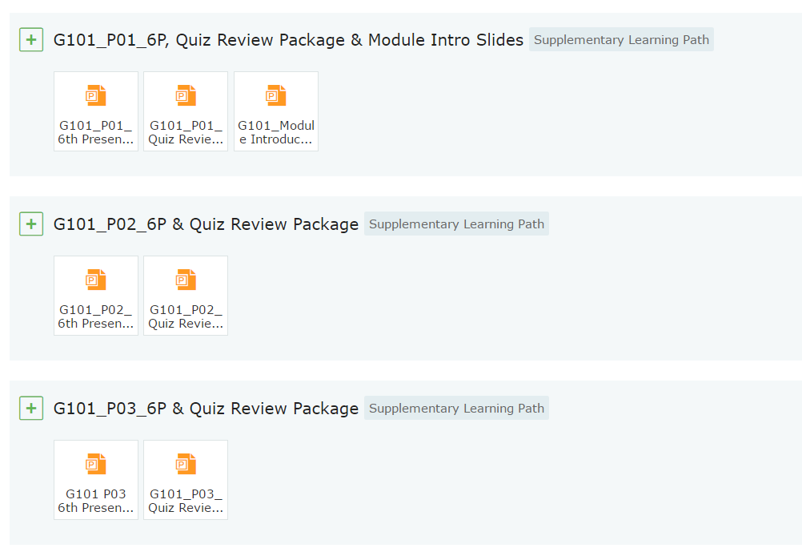
Quiz Reviews
You may want to revise all your quizzes using the Quiz Review Package from Problem 2 – 11.
Go to LEO 2.0 -> Learning Path -> (Scroll down the page) Supplementary Path. (see screenshot below)

Slide 30
Happy Revision!

